Slide 1
First Class of Python

Slide 2
Getting to know each other
Are you familiar with Programming?
Which programming languages (Java, C, C++, Python, JavaScript, etc) do you know?
Do you know HTML?
How much would you rate yourself in Python out of 10?

Slide 3
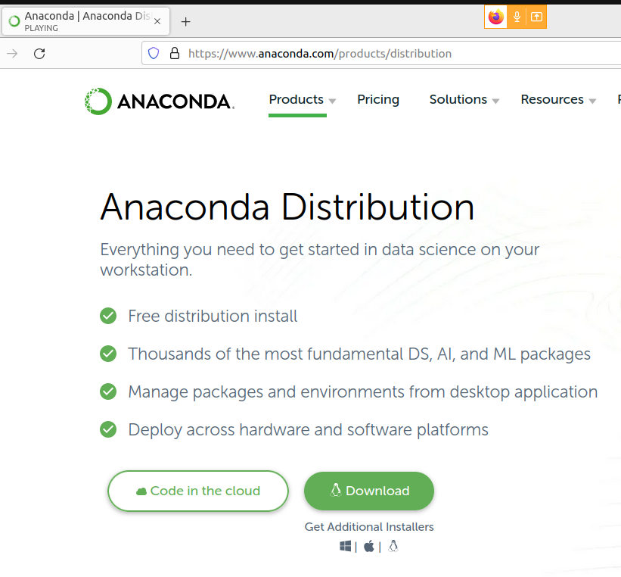
Where to run our Python Code?
URL: https://anaconda.org/

Slide 4
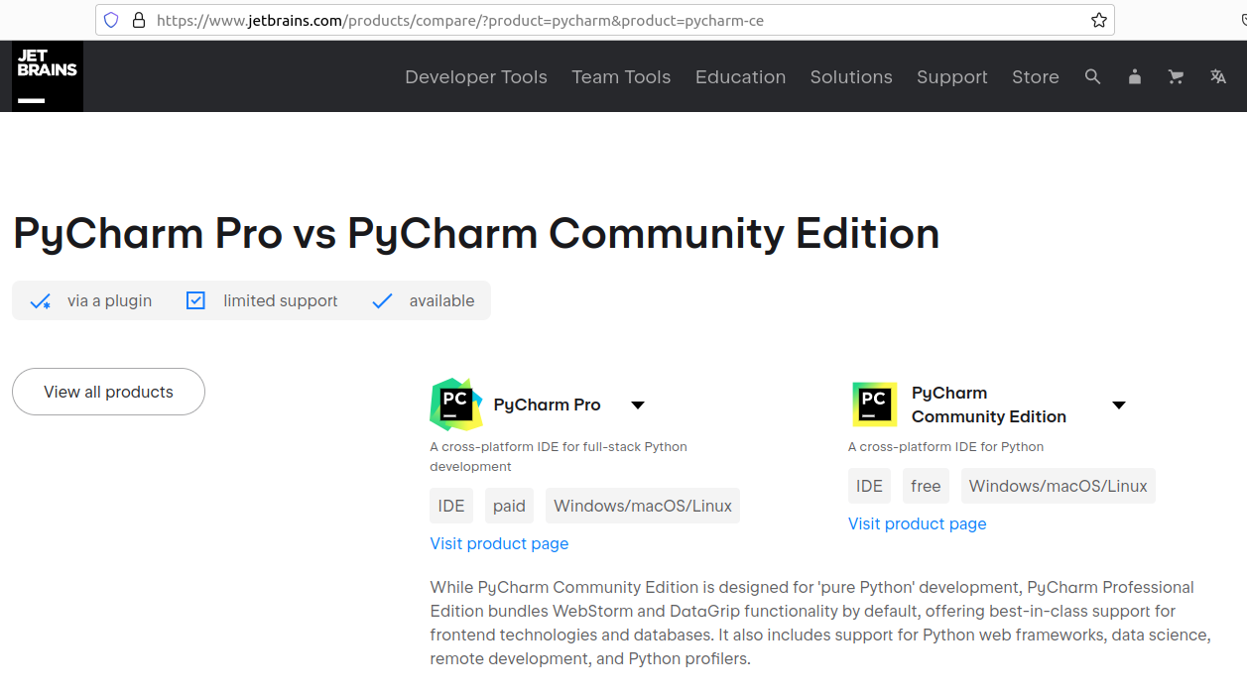
PyCharm

Slide 5
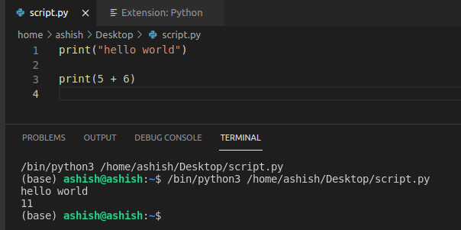
In Visual Studio Code
URL: https://code.visualstudio.com/download

Slide 6
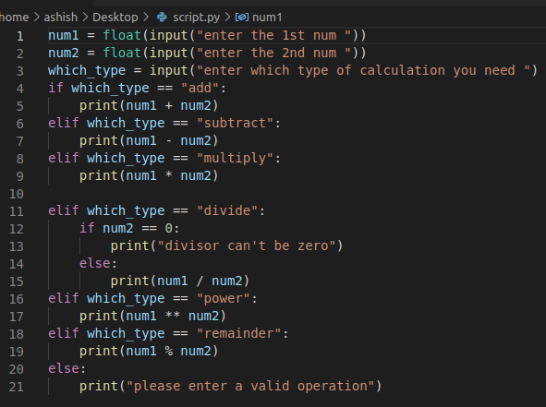
Calculator: We intend to demonstrate simple arithematic operations on numbers
1. How to take to input?
2. Operators:
Assignment operator: Line 1
Equality operator: Line 4
Addition operator: Line 5
Modulo operator: Line 19
3. String comparison

Slide 7
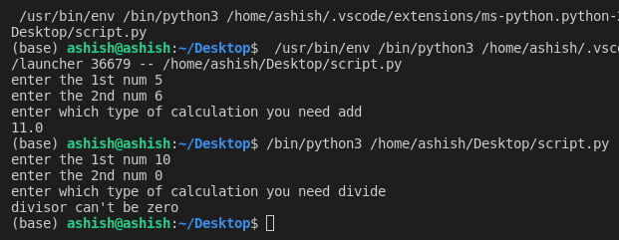
Calculator: Output

